Slide 1

Restaurant Ordering App
Alsalt Alkharusi and Yaqoob Al Farsi

Slide 2
Proceedings
Project Scope
Objectives
Phases of Project
Architecture Design
Activity Diagram
Application Interfaces
Notes:
Agenda of our today presentation is divided in to 6 main topics. We will start with Project Scope by defining the scope of our proposed system. Then we will state the objectives of our app then we will move to phases of project and explain the phases with the help of a gantt chart. After that architecure design of the app will be discussed following by the activity diagrams and the application interfaces.

Slide 3
Project Scope
Allocation of approximately all restaurants on the map
Updated Menu of restaurants
Placing order to appropriate restaurant
Pay through an online service
Receiving invoice from the restuarant
Notes:
In todays age of fast food and take-out, many restaurants have chosen to focus on quick preparation and speedy delivery of orders rather than offering a rich dining experience. Our project covers the online ordering domain of restaurants.
The main advantage of oursystem is that it greatly simplifies the ordering process for both the customer and the restaurant

Slide 4
Objectives
Easy approach to place order
Quick service by restaurants
Deliver fresh food to customers(s) at their doorstep
Secure way to pay online and increasing customer satisfaction
Notes:
Main aim of our project is to simplify and improve the efficiency of the ordering process for both customer and restaurant. Our system will minimize manual data entry and ensure data accuracyand security during order placement process. Customers will also be able to view product menus and track his order and be able to have a visual confirmation that the order was place correctly.

Slide 5
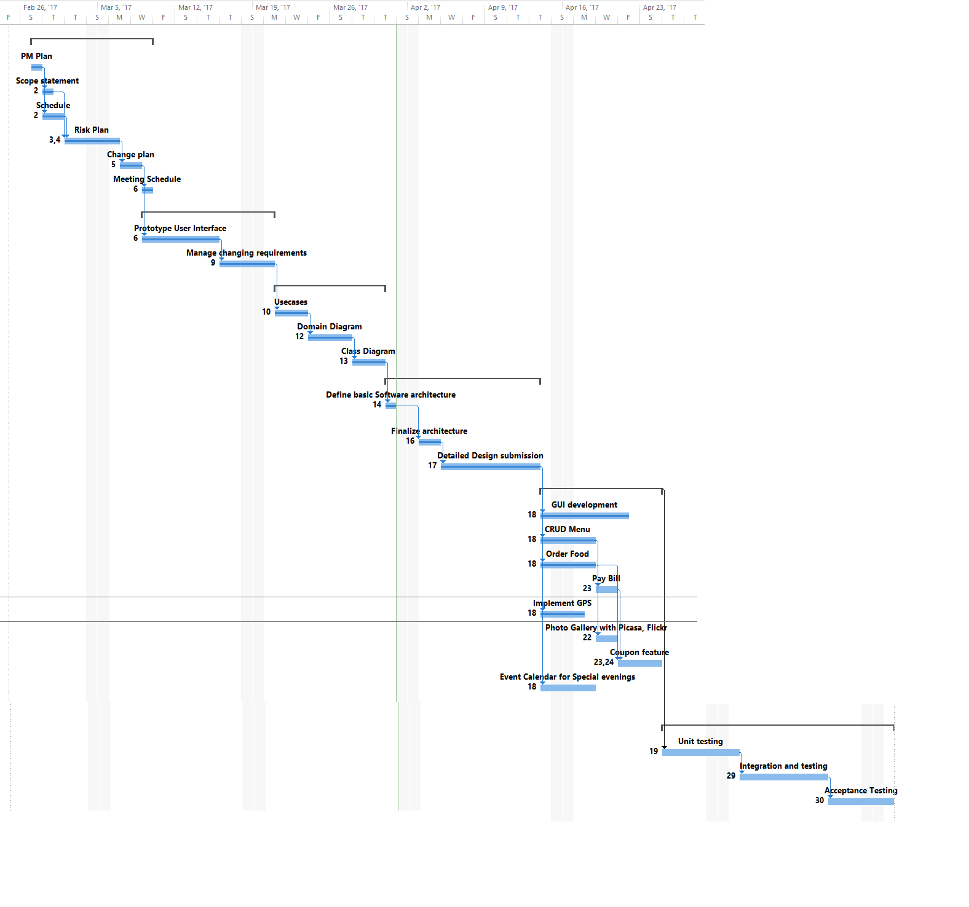
PHASES OF PROJECT
Notes:
In this gantt chart all the phases of the project is illustrated.Our first phse of the project is PM Plan which includes the Scope, Schedule,Risk Plan,change plan and meeting schedule. After completion of this phase, prototype user interface phase started following by manager changing requirement. When this phase completed,then design phase start in which we design usecases,domain diagrams, class diagrams and finalize software architecture. After designing phase, development phases started in which we develop GUI for our different usecases of our app. After development we test and integrate our app.

Slide 6
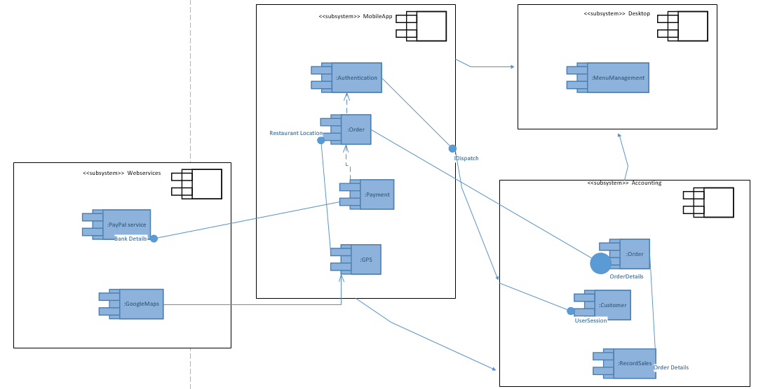
Architecture Diagram – Component Based
Notes:
The application is divided into 4 main modules : Webservices, MobileApp module , Desktop module and the accounting module
Mobile contains 4 components the AUTHENTICATION , order payment and GPS. Authentication component require data about customer’s accounts. Order component sends the order details to the component of an accounting module
PAYMENT is dependent upon ORDER
ORDER requires data about restaurant location, hence it connect with GPS, GPS component is dependent upon GOOGLEMAPS webservice of the module WEBSERVICES
RECORD SALES component of the ACOOUNTING module requires data related to ORDERS
The WEBSERVICES in this system are PAYPAL and GOOGLE MAPS

Slide 7
User Story Realization
As a user of online ordering application I want a quick approach to found all the restaurants around my location with their updated menu.
The application should be very much responsive and user friendly with restaurants delivering order on time.
Moreover, it should keep the user’s data secure so that I can freely add my personal as well as account details when using this application.

Slide 8
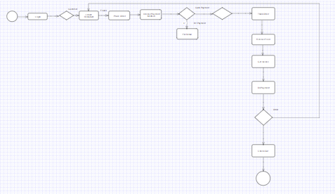
Activity Diagram
Notes:
When a user login to our app,it will decide based on the login credentials that which type of user he is. If he is customer then he will locate his required restaurant and place order. After placing order he will chose his payment method whether he will payvia credit card or by paypal.After payment, he cal also track his order until the order received.Once the order received, he got the invoice of this order and he can give another order or just enjoy the order he received.

Slide 9
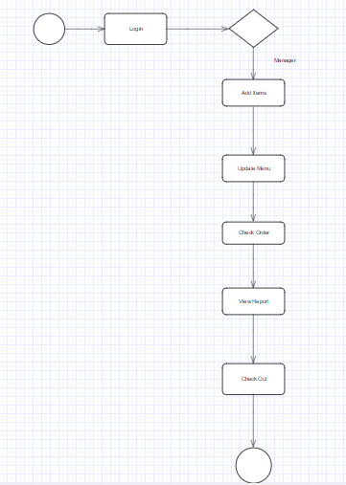
Activity Diagram
Notes:
When a user login to our app,it will decide based on the login credentials that which type of user he is. If he is manager then he can perform his managerial task like Add Items, Check Orders and View reports.

Slide 10
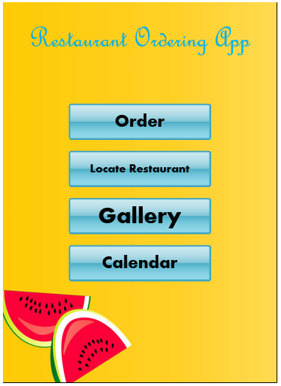
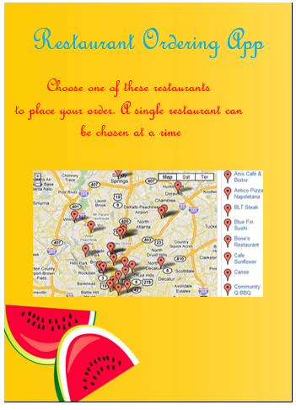
LOCATE RESTAURANT GUI
Notes:
This is our application's main GUI for customers where he can locate restaurant by using the Locate restaurant button present in menu.

Slide 11
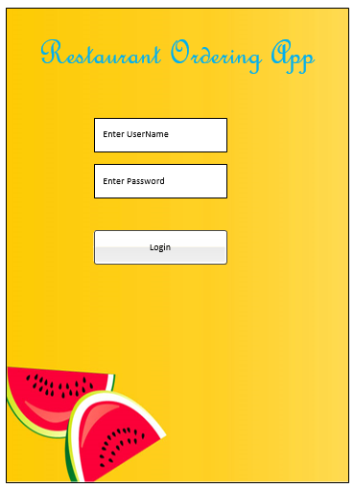
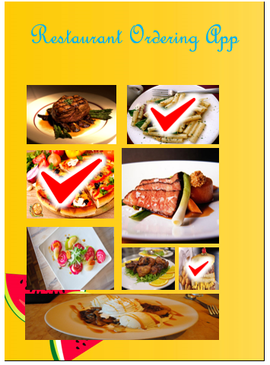
PLACE ORDER GUI
Notes:
After locating restaurant, he can place his order via main menu.

Slide 12
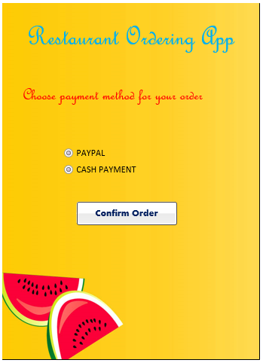
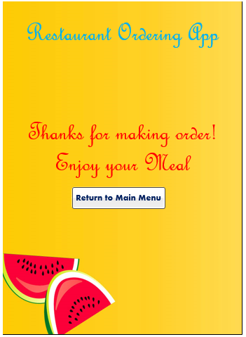
SELECT PAYMENT METHOD GUI
Notes:
Once he made the order then he can select his method of payment.

Slide 13
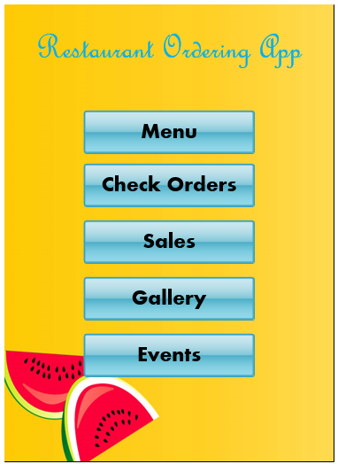
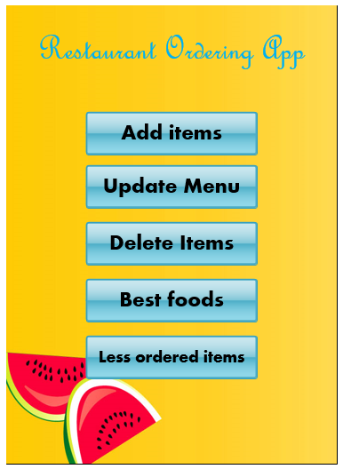
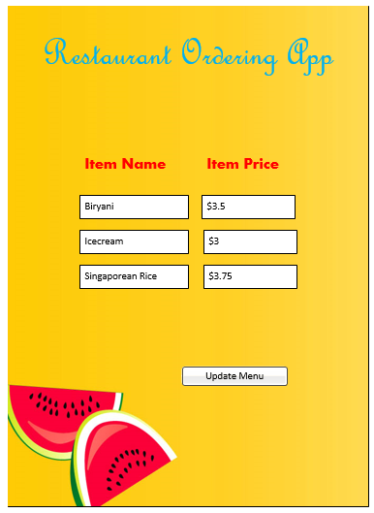
SELECT ITEM GUI
Notes:
This is manager's main GUI. Here he can add items by using sub menu.

Slide 14
UPDATE MENU GUI
Notes:
Manager can update menu by using the sub menu of his main manu. Where he can update item price and name.

Slide 15
Any Questions ?

Slide 16
Thank You Have a Nice Day ☺

